Slide 1
PREDICITNG OPTIMAL CITY & LOCATION FOR A BUSINESS VENTURE
GROUP 15

Slide 2
AGENDA
The Scope
Problem
Background
Data Source
The Data
Data Description
Data Preparation
Data Exploration
Model and Analysis
Results and Inferences

Slide 3
THE SCOPE
The scope of this project is limited to restaurants in New York, Los Angeles, and Chicago while the extensibility of the project is limitless. The project and the codes can be applied to any business ventures.

Slide 4
PROBLEM
To analyze and predict an optimal location to open a restaurant from a pool of major cities in the United States
To predict a competitive location in each city
To find the ideal cuisine for each location

Slide 5
BACKGROUND
In this project we inspect three major cities in the United States (New York, Los Angeles, and Chicago) considering the population density
The touristic aspect of each city are also taken into consideration
The number of hotels and a general foot traffic is considered as a base for this project

Slide 6

DATA SOURCE
Foursquare API is the primary source of data in this project. (https://developer.foursquare.com/)
Two Datasets for each city were retrieved, cleaned and prepared for analysis
Hotel dataset with locations
Restaurant dataset with categories and locations
Hence, a total of 6 datasets were used for this project

Slide 7
DATA DESCRIPTION
We gather data for 3 major cities in the United States (New York, Los Angeles & Chicago)
For each Hotel & Restaurant, we have the following attributes
Categories
Number of Hotels & Restaurants within a radius
Address
Coordinates
Distance from a center point
Zip code
City and State
Cuisine type

Slide 8
DATA PREPARATION
DATA CLEANING
A ‘Search’ query was made to the Foursquare API
Related attributes were kept, and the rest were dropped using ‘dropna()’
Categories other than Hotel & Restaurants were dropped.
An ‘explore’ call was made to the API to get the trending spot based on foot traffic

Slide 9
DATA PREPARATION (contd.)
DATA CLEANING
The API also provided us with data such as ID, referral ID, venue page labels, delivery ID etc. which is of no significance in this project and hence they have been dropped from the DataFrame.

Slide 10
DATA EXPLORATION
LIBRARIES USED
NUMPY
PANDAS
pd.set_option: Customize aspect of pandas
JSON
JSON is text, written with JavaScript Object Notation
JSON_NORMALIZE
Normalize semi structured JSON data into a flat table

Slide 11
DATA EXPLORATION (contd.)
LIBRARIES USED
MATPLOTLIB.PLT
For plotting charts
MATPLOTLIB.CM & MATPLOTLIB.COLORS
Built in color maps and color handling utilities
SKLEARN.CLUSTER – KMEANS
Clustering of unlabeled data
SKLEARN.NEIGHBORS – KNEIGHBORSCLASSIFIERS
FOLIUM
To visualize a data on a map

Slide 12
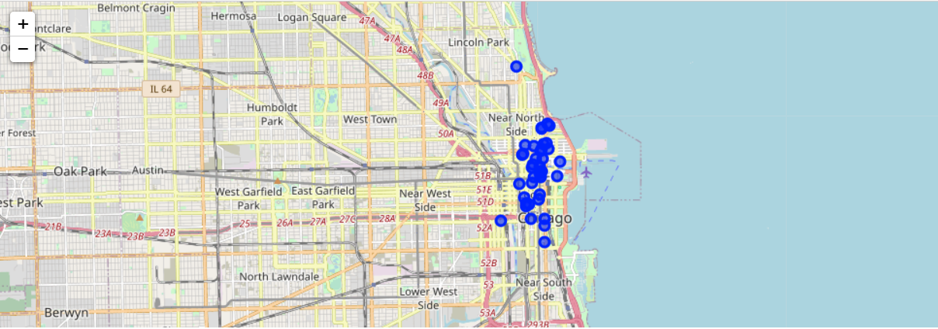
DATA EXPLORATION (contd.)
FOLIUM LIBRARY:
Python library for visualizing geospatial data
Hotel & Restaurants data were visualized on a map to determine the clusters
Fig: Folium output for hotels in Chicago

Slide 13
MODEL & ANALYSIS
FINDING LOCATION
We have targeted the downtown location of each city
considering:
The density of hotels (where people/tourist are more likely to visit)
Proximity to the city center
The data is collected accordingly from the Foursquare API by selecting suitable coordinates and radius

Slide 14
MODEL & ANALYSIS (contd.)
K-Means Clustering:
An ML clustering algorithm that could find similarities among data and group accordingly
Finding the appropriate number of clusters is a challenge
Folium library helps to sort this challenge
3 clusters were found out to be the appropriate number

Slide 15
MODEL & ANALYSIS (contd.)
K-Means Clustering:
The output from the clustering was added as a column to the DataFrame
The center of each clusters and its coordinates were added to the DataFrame for analysis
The above-mentioned outputs were visualized on maps and centers marked with larger circles

Slide 16
MODEL & ANALYSIS (contd.)
Locating the best spot:
Analyze the competition in each city/cluster and ideal cuisine for the same
Classify the trending restaurants data retrieved from Foursquare API into clusters obtained from the K-Means algorithm
K Nearest Neighbors Classification (KNN) is used

Slide 17
MODEL & ANALYSIS (contd.)
K Nearest Neighbors Classification (KNN):
Assigns a class label to each data point according to the most frequent class among the nearest, user defined ‘K’ number of neighbors.
Therefore, assigned a class label to each restaurant in a data frame
The clusters’ centers’ location data is used as a training set
“K” value of ONE - to assign the label of the closest single center to the data point in the restaurant's dataset.

Slide 18
MODEL & ANALYSIS (contd.)
EVALUATION:
Simple evaluation is to take the count in each cluster, do a comparative study and choose the one with the lowest competition [ex: sum()/size()]
To find the ideal cuisine, groupby() by categories and count() are used
The result derived is plotted on a bar chart

Slide 19
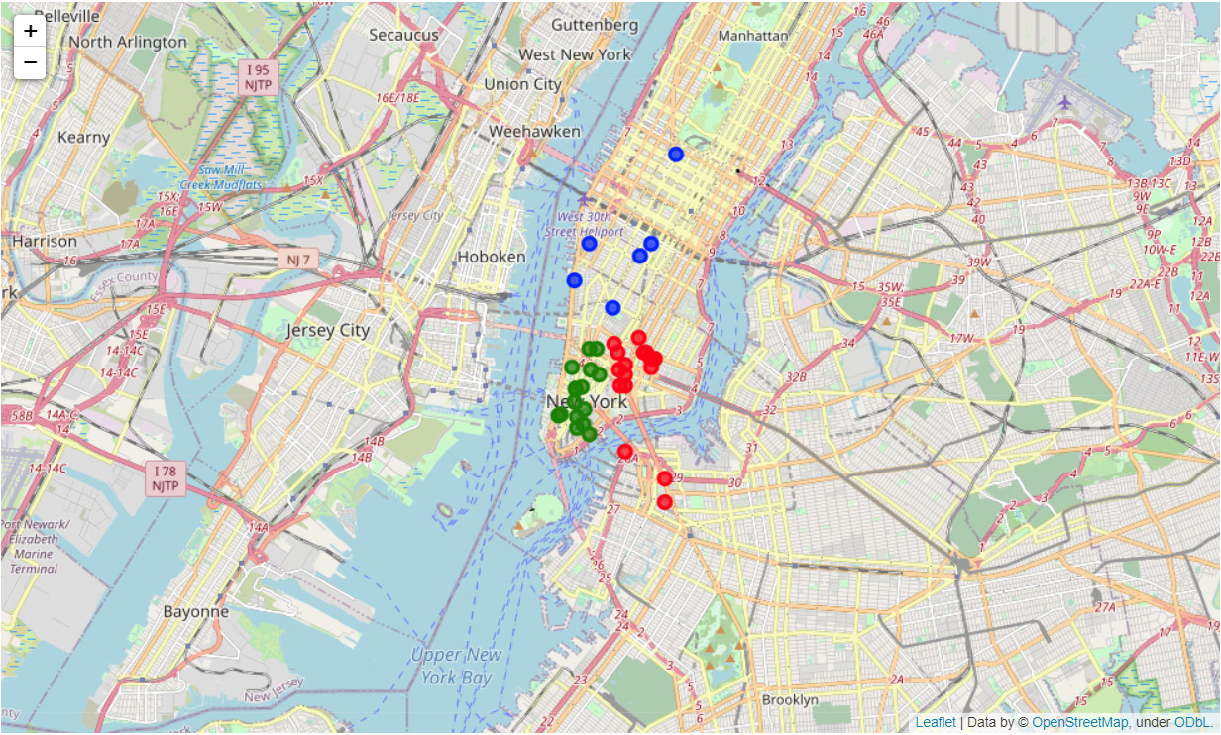
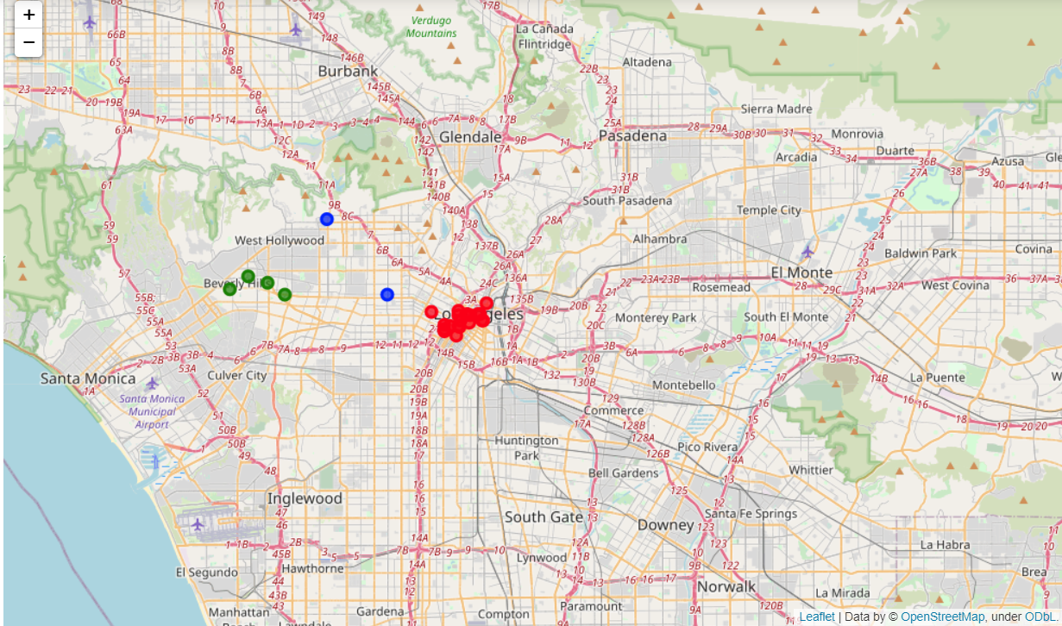
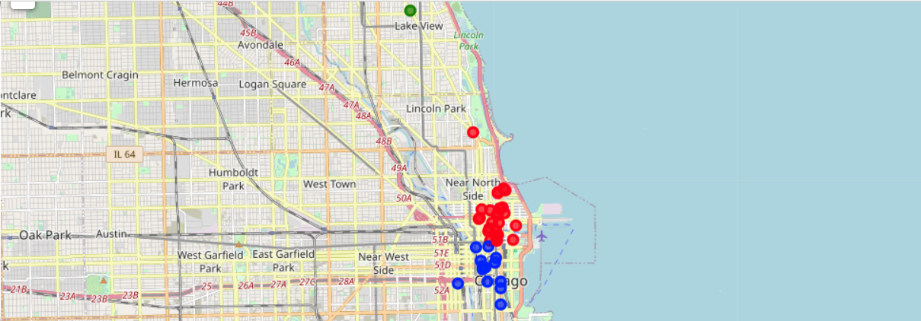
RESULTS & INFERENCES
HOTELS CLUSTERING:
After clustering, the resulting DF is visualized as
Los Angeles
New York
Chicago

Slide 20
RESULTS & INFERENCES (contd.)
LOCATING THE CENTERS OF CLUSTERS:
The second output of the K-Means clustering algorithm
CITY | CLUSTERS | LATITUDE | LONGITUDE
NEW YORK | 0/Red | 40.6967 | -73.9880
 | 1/Green | 40.7246 | -73.9946
 | 2/Blue | 40.7127 | -74.0083
LOS ANGELES | 0/Red | 34.0682 | -118.3832
 | 1/Green | 34.0501 | -118.2529
 | 2/Blue | 34.0633 | -118.3006
CHICAGO | 0/Red | 41.8929 | -87.6264
 | 1/Green | 41.9478 | -87.6572
 | 2/Blue | 41.8781 | -87.6294

Slide 21
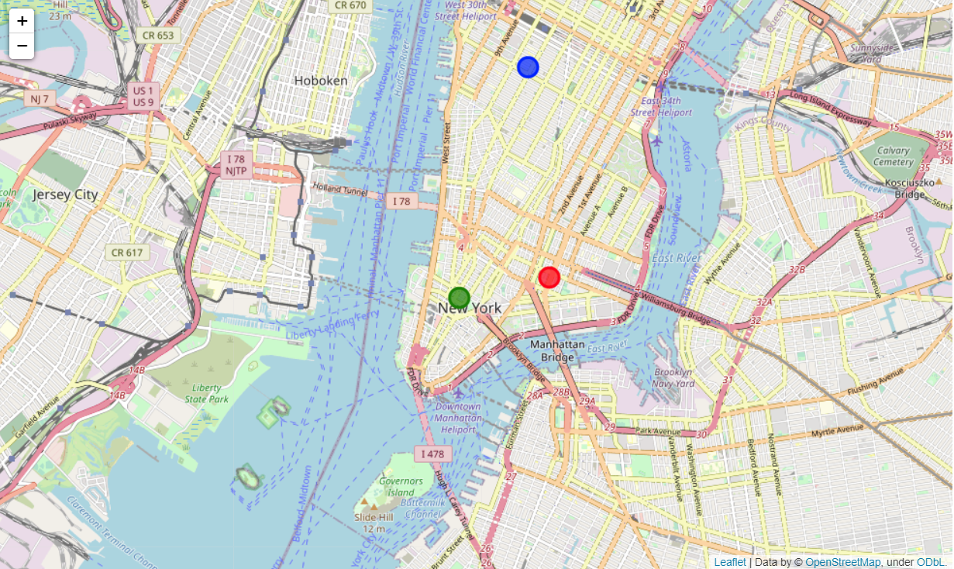
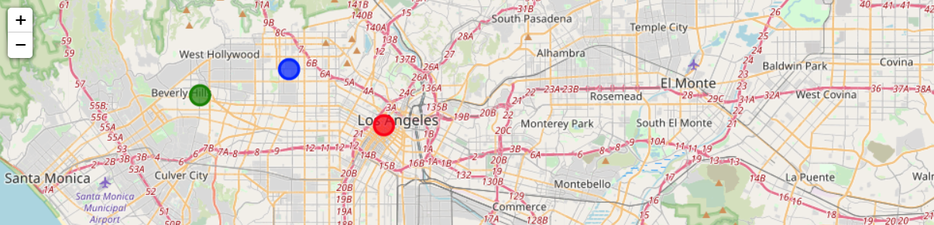
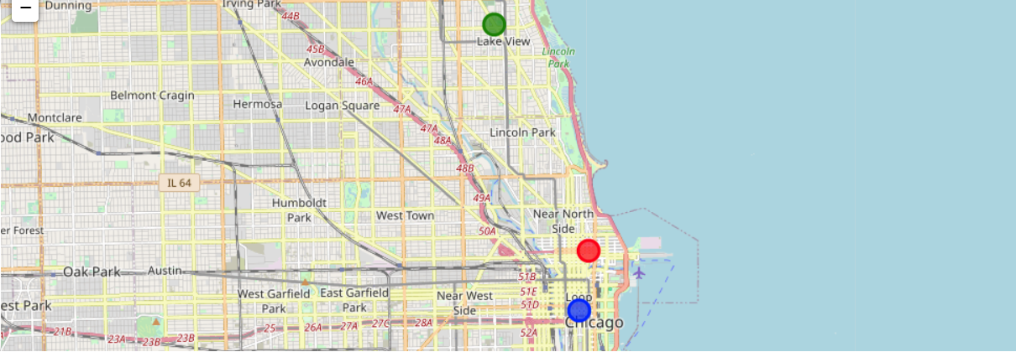
RESULTS & INFERENCES (contd.)
LOCATING THE CENTERS OF CLUSTERS:
Folium output of hotel cluster centers
Los Angeles
New York
Chicago

Slide 22
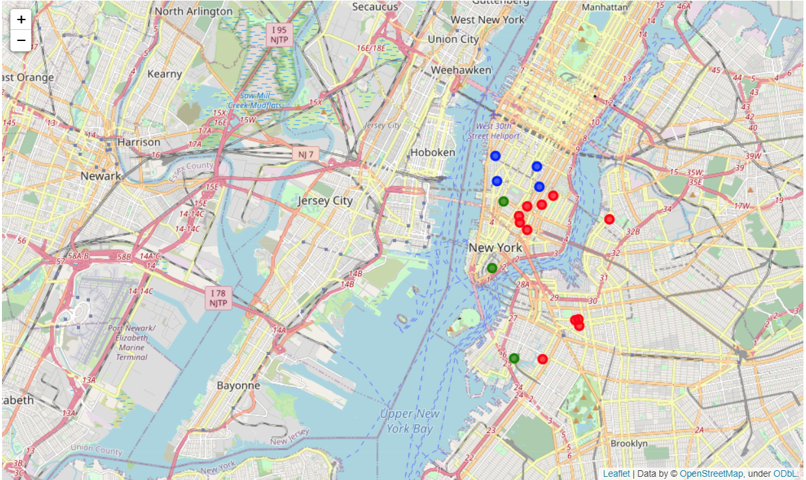
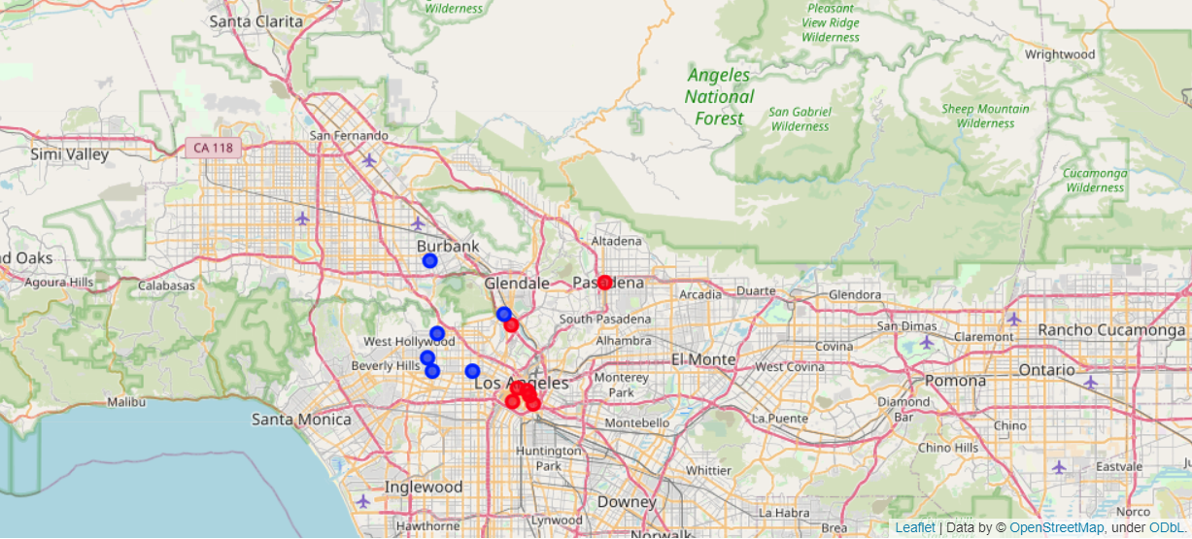
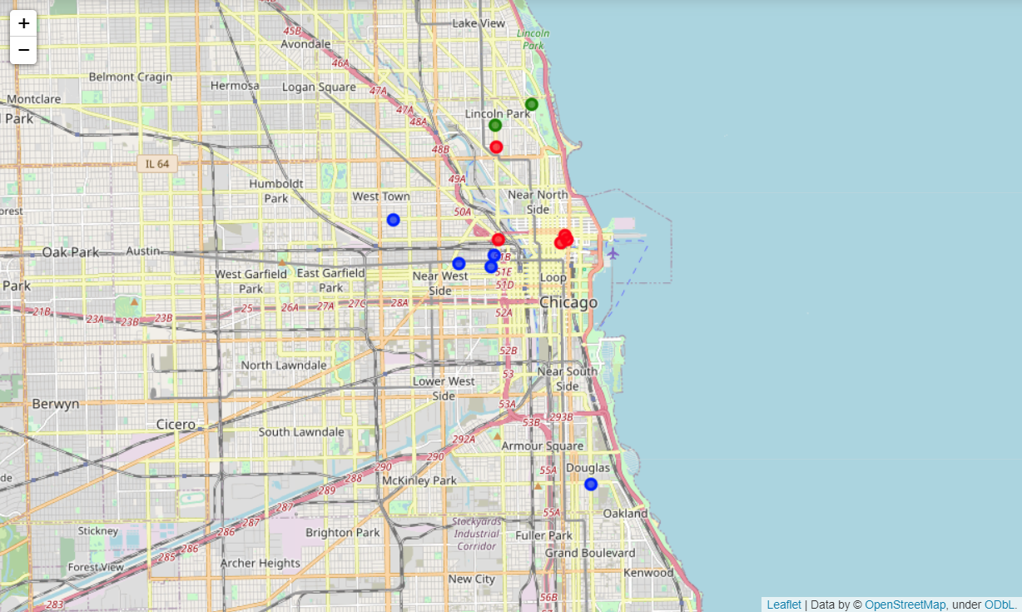
RESULTS & INFERENCES (contd.)
RESTAURANT CLASSIFICATION:
KNN Classification algorithm output
Los Angeles
New York
Chicago

Slide 23
RESULTS & INFERENCES (contd.)
RESTAURANT COUNT:
CITY | CLUSTER | NO. OF RESTAURANTS
NEW YORK | 0/Red | 5
 | 1/Green | 13
 | 2/Blue | 1
LOS ANGELES | 0/Red | 3
 | 1/Green | 7
 | 2/Blue | 3
CHICAGO | 0/Red | 5
 | 1/Green | 2
 | 2/Blue | 4

Slide 24
RESULTS & INFERENCES (contd.)
HOTEL COUNT:
CITY | CLUSTER | NO. OF HOTELS
NEW YORK | 0/Red | 3
 | 1/Green | 19
 | 2/Blue | 14
LOS ANGELES | 0/Red | 4
 | 1/Green | 20
 | 2/Blue | 1
CHICAGO | 0/Red | 27
 | 1/Green | 1
 | 2/Blue | 13

Slide 25
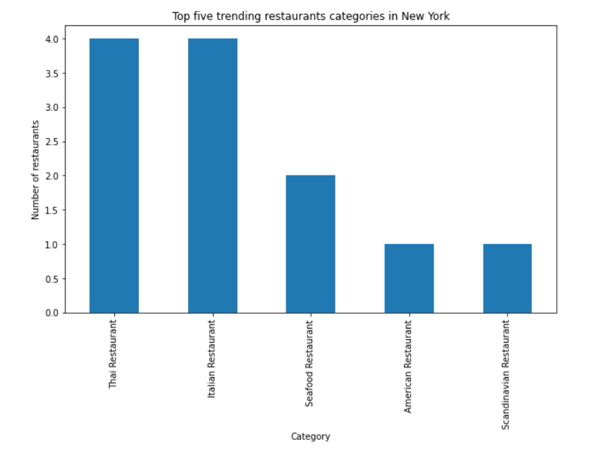
RESULTS & INFERENCES (contd.)
IDEAL CUISINE/CATEGORY:
Since the data represents locations with highest foot traffic, the category frequency is taken into consideration

Slide 26
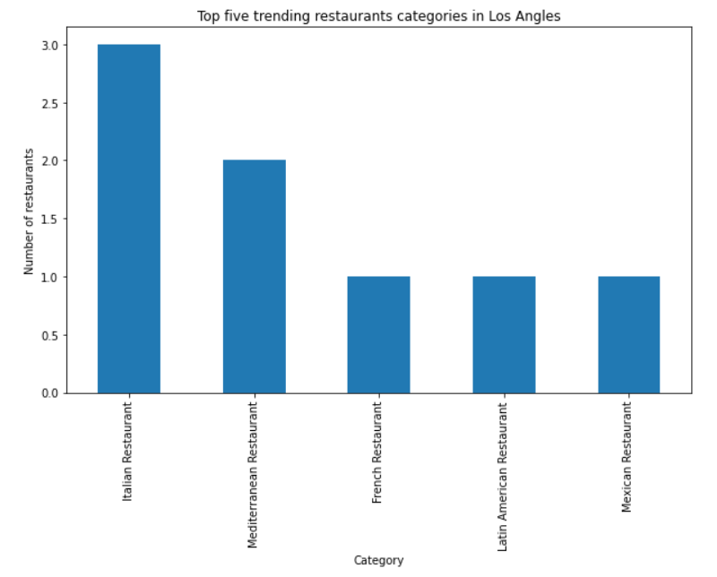
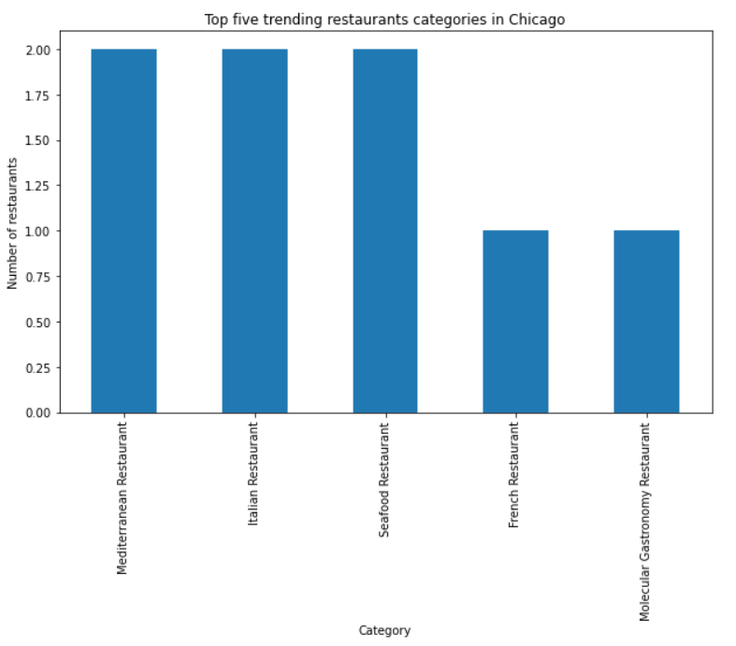
RESULTS & INFERENCES (contd.)

Slide 27
DISCUSSION
NEW YORK:
Hotel cluster 2 has 14 hotels with just one Restaurant.
Thai and Italian Restaurant seems to be trending.
There is no Italian Restaurant in cluster 2.
Therefore, Opening an Italian restaurant in cluster 2 & closer to (40.7127 & -74.0083) coordinates seems ideal.

Slide 28
DISCUSSION (contd.)
LOS ANGELES:
Hotel cluster 1 has 20 hotels with seven Restaurants.
Italian Restaurant seems to be trending.
Therefore, Opening an Italian restaurant in cluster 1 & closer to (34.0501 & -118.2529) coordinates seems ideal

Slide 29
DISCUSSION (contd.)
CHICAGO:
Hotel cluster 0 has 27 hotels with just five Restaurant.
Mediterranean and Italian Restaurant seems to be trending.
Therefore, Opening an Italian restaurant in cluster 0 & closer to (41.8929 & -87.6264) coordinates seems ideal

Slide 30
CONCLUSION
Altogether, the numbers say opening an Italian restaurant in the city of New York closer to (40.7127 & -74.0083) is ideal.
In this project, we tried predicting an optimal location and ideal cuisine for opening a restaurant in New York, Los Angeles and Chicago. Clustering algorithms and folium mapping were used to predict the results. This project and its algorithms can be applied to any other business/undertaking.

